Slide 1














A WEBSITE FOR
COEP’S DRAMA AND FILM CLUB
SUMEDH CHAVAN | CHINMAY BARVE

Slide 2

PROBLEM & OPPORTUNITY
Need for a website for DNFC club to showcase their creations and achievements
Making use of newer technologies for the process of content creation and analysis to the next level

Slide 3

OBJECTIVES
Build a prototype website which can be improvised further
Make use of LLM to improve the process of content creation and analysis
Learn and Implement Principles of Object Oriented Programming

Slide 4
OVERVIEW OF THE PROJECT
A Web app using Flask.
Beautiful and dynamic landing page, about us, features, etc.
User login/signup management.
The unique features
Content analysis
Monologue generation
Script Reader

Slide 5

THE WEB APP
FRONT END : HTML, CSS, BOOTSTRAP, JS
BACK-END : Flask
Made use of Bootstap library to enhance frontend of application
Use of flask_login for user authentication.
Use of flask_sqlalchemy for database management.

Slide 6
OOP IN WEB DEVELOPEMNT
Modularity and Encapsulation: Organize code into separate files and modules
Classes and Objects: Utilize classes and objects, particularly in defining SQLAlchemy models
Inheritance: Flask class serves as the superclass.
create_app function creates an instance of the Flask application, inheriting properties and methods
Abstraction: Provides simple, intuitive interface for defining routes, handling requests, and interacting with the database

Slide 7
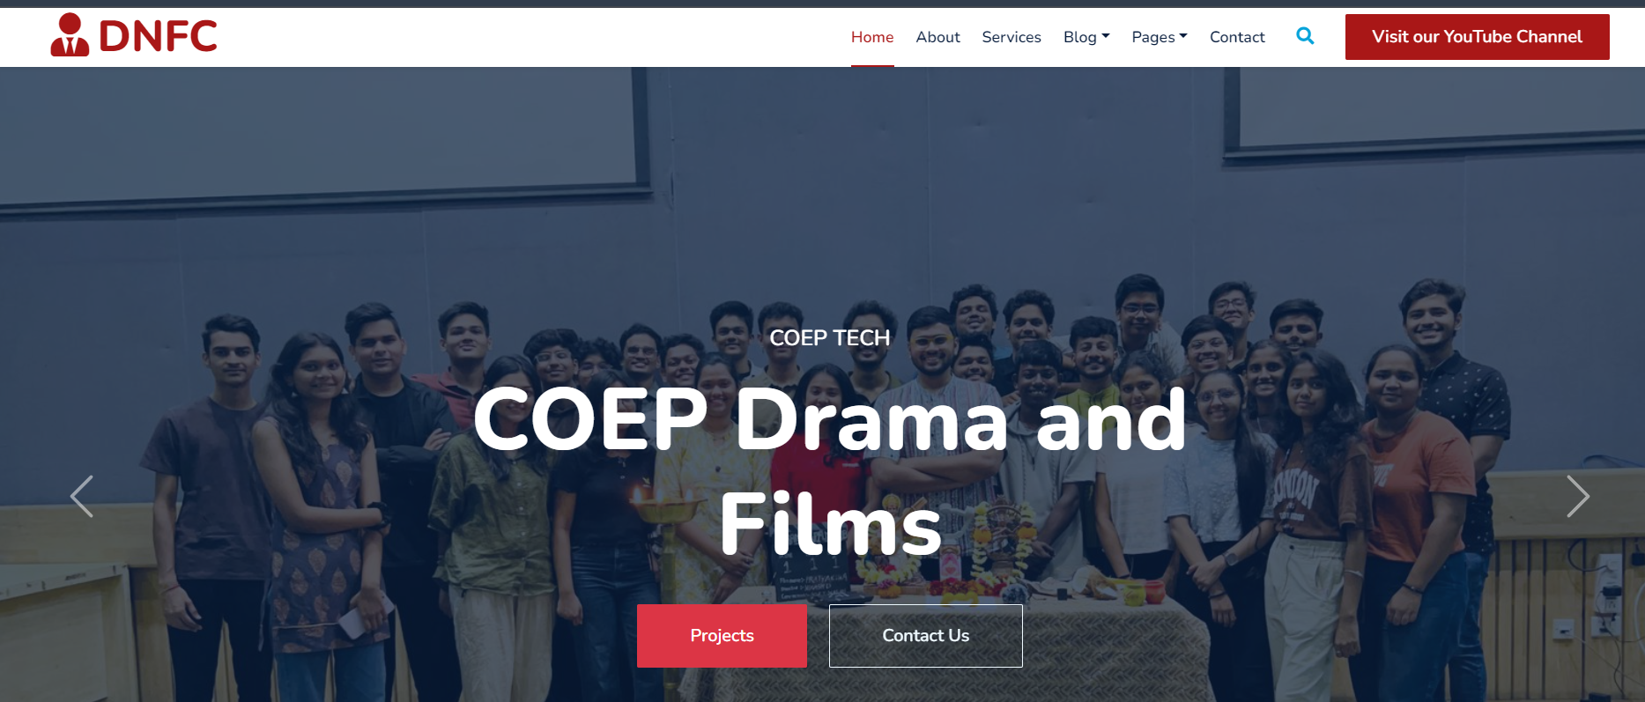

Slide 8
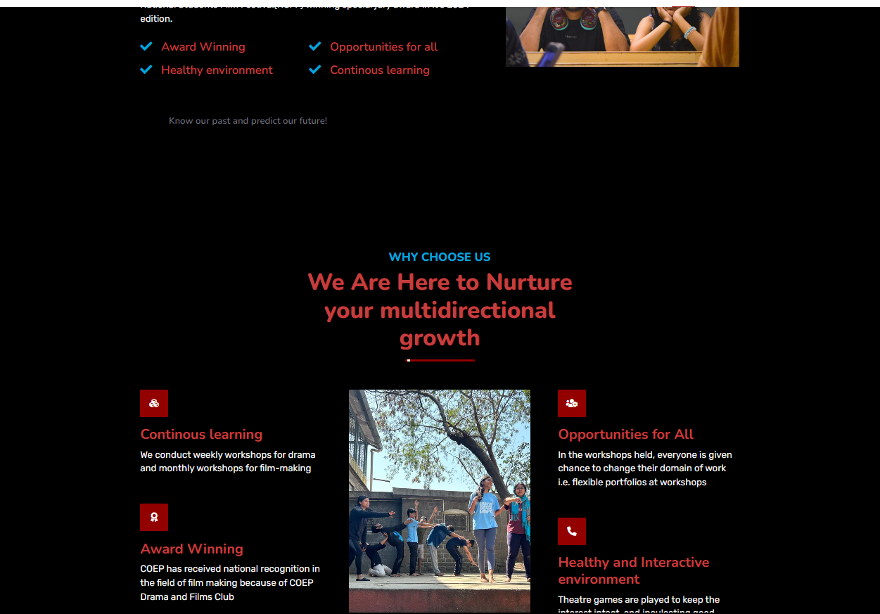

Slide 9
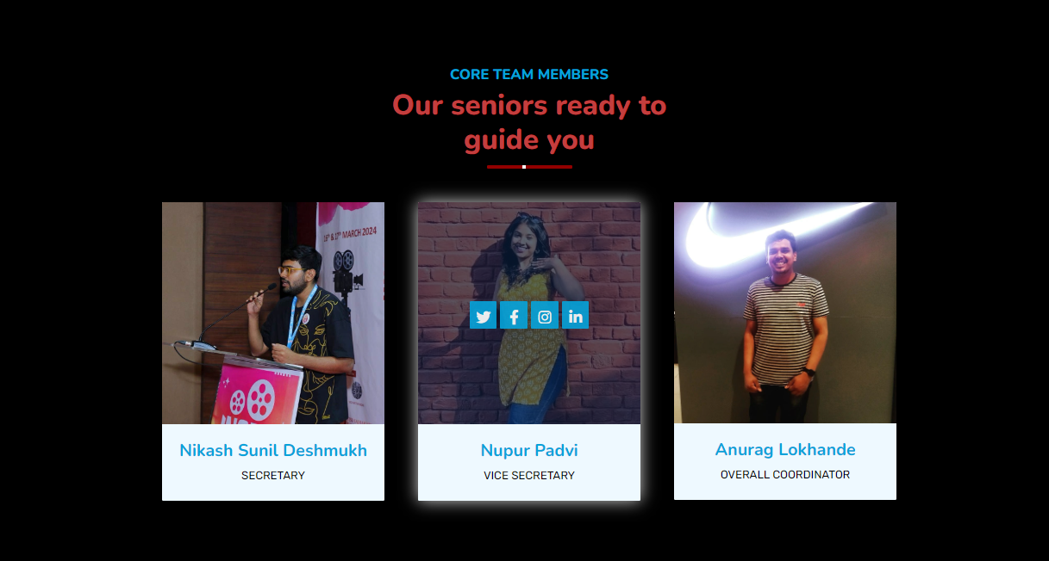

Slide 10

COMMENT ANALYSIS
TECH USED : Google Gemini api, YouTube data api, langchain, hugging face model, wordcloud, matplotlib
Sentiment analysis of english using cardiffnlp/twitter-roberta-base-sentiment-latest
Sentiment analysis of Marathi comments using l3cube-pune/marathi-sentiment-md
Sarcasm and Contructive feedback detection using Google Gemini model

Slide 11
OOP IN COMMENT ANALYSIS
Encapsulation: Importing libraries like requests bundles specific tasks, hiding implementation details.
Classes and Objects: Defined classes like ChatGoogleGenerativeAI serve as blueprints for encapsulating data and functionalities.
Inheritance: Libraries such as transformers leverage inheritance extensively for providing functionality, inheriting methods for various tasks.
Encapsulation (Function Level): Functions like get_comments encapsulate specific functionalities, bundling data and methods within themselves

Slide 12
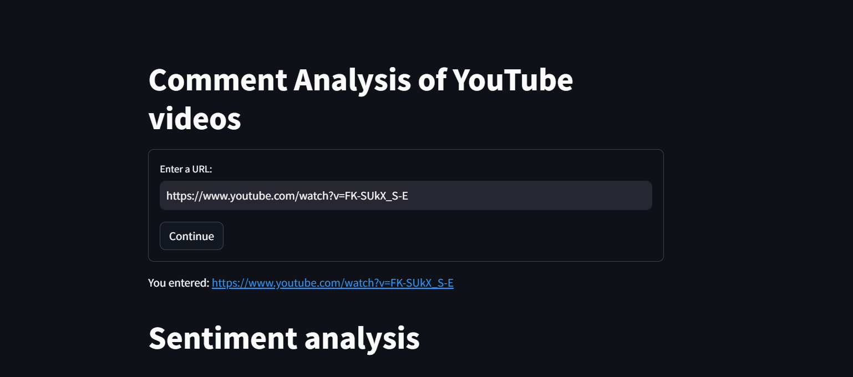

Slide 13
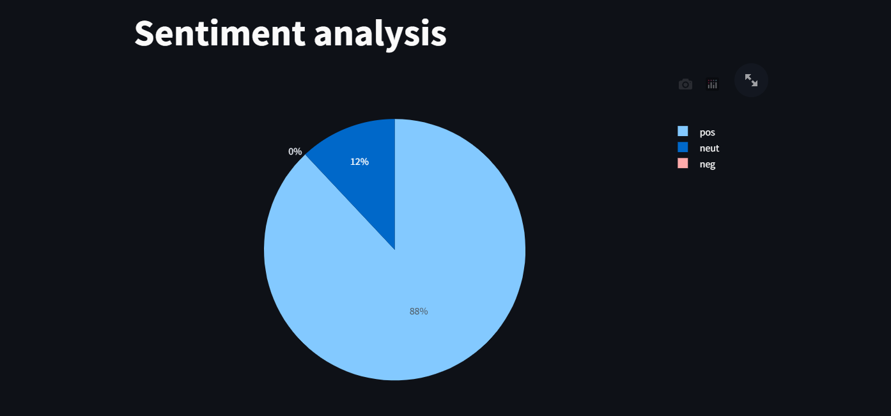

Slide 14
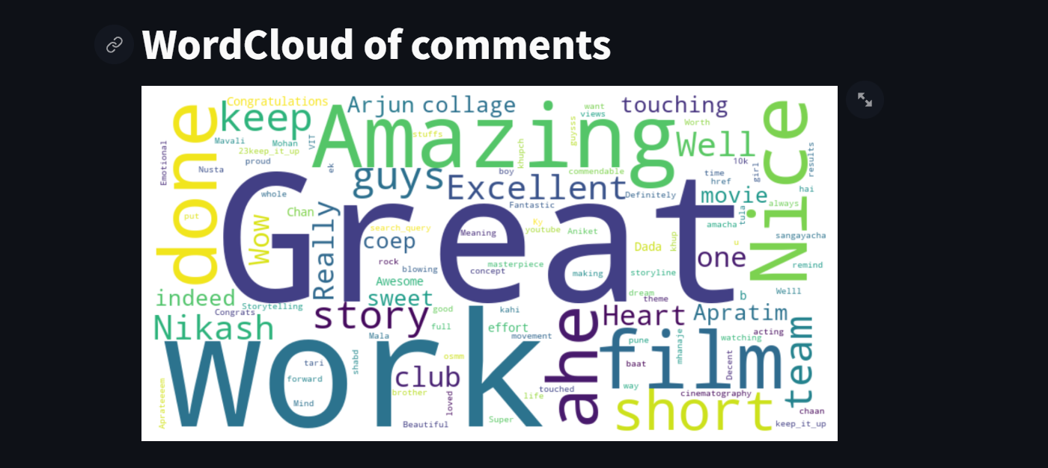

Slide 15
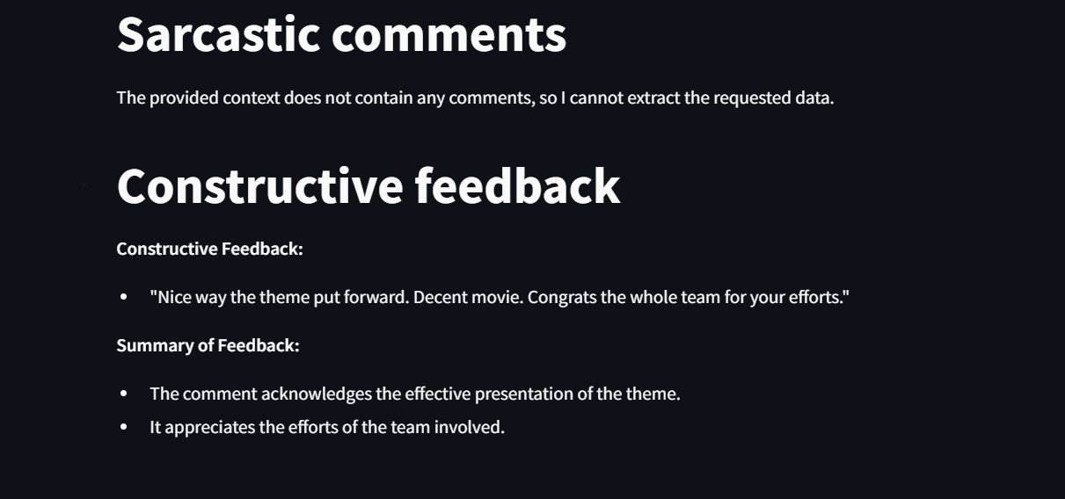

Slide 16

MONOLOGUE GENERATION
TECH USED : Google Gemini api, OpenAI Embeddings, langchain, FAISS
Monologue are converted to embedding using OpenAI embedding and stores in vectorstore FAISS
User expresses his query and it is converted into embeddings as well.
similarity search is done between the embedding of user query and monologues stored in vectorstore.
most relevant monolgues are fetched and rendered via Google Gemini models

Slide 17
OOP IN MONOLOGUE GENERATION
Encapsulation: Classes like ChatGoogleGenerativeAI, OpenAIEmbeddings, etc., encapsulate specific functionalities and data within their scopes, showcasing encapsulation in action.
Polymorphism: The RetrievalQA class demonstrates polymorphism by responding differently to the same method invocation (get_qa_chain) based on the type of question-answering chain required, exemplifying the concept in practice.

Slide 18
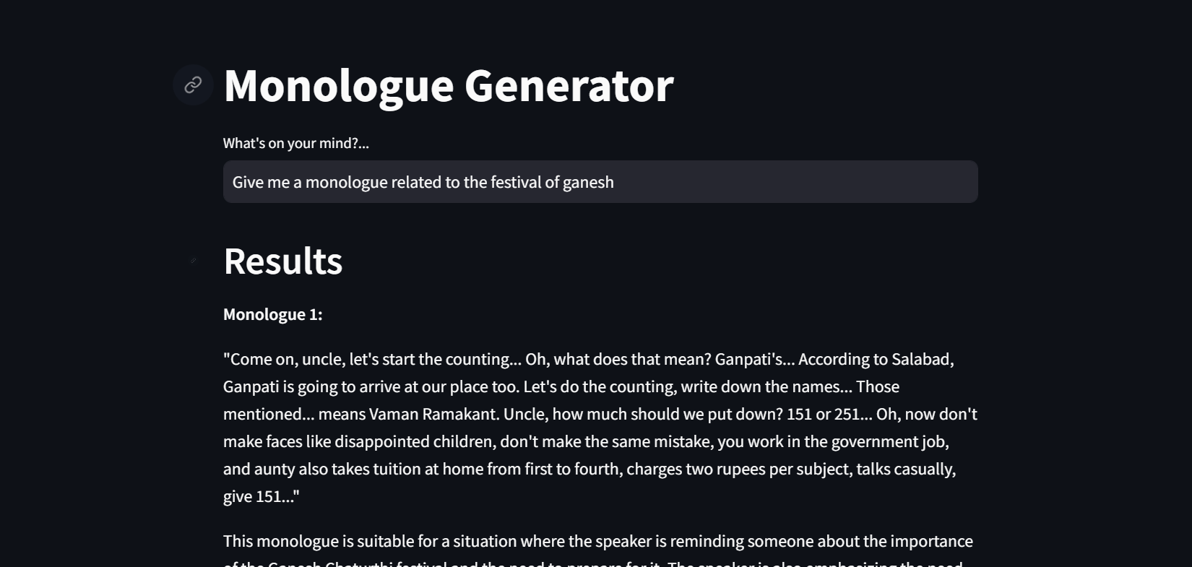

Slide 19
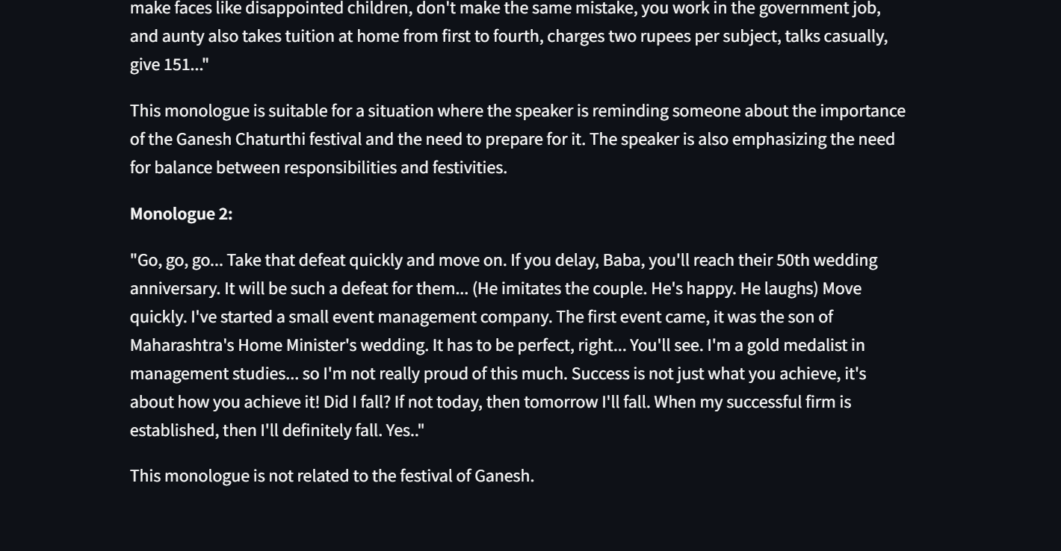

Slide 20

SCRIPT ANALYSIS
TECH USED : Google Gemini api, OpenAI Embeddings, langchain, FAISS
Uploaded pdf is converted into embeddings.
user’s query is converted into embedding.
by using similarity search the most relevant answer to the user question is found

Slide 21
OOP IN SCRIPT ANALYSIS
Access Specification Principles: Private attributes are indicated by prefixing names with a single underscore, ensuring encapsulation.
Abstraction: Users interact with the ScriptReader class through the run_script_reader method, abstracting away internal complexities.

Slide 22
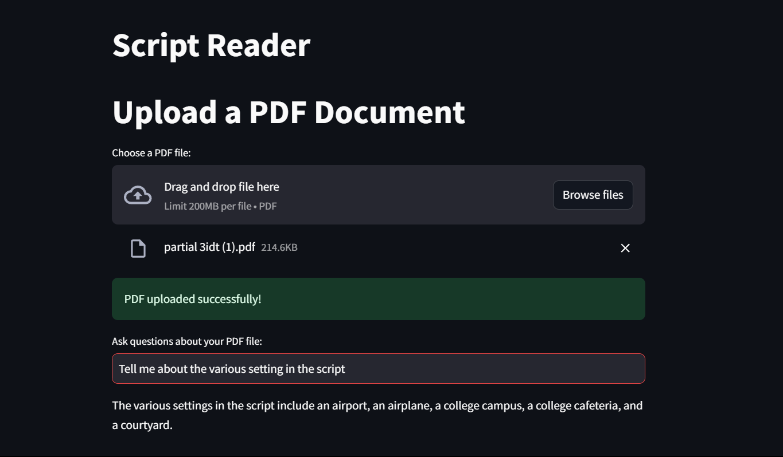

Slide 23









LLM sometimes produce unreliable results
LLM models require a lot of resources to run
CHALLENGES RELATED TO LLM APPLICATIONS
high learning curve associated with development or training an LLM
Constantly changing domain, thus frequent changes in support libraries
LLM models are huge and require a lot of space
Due to lack of available resources , debugging issues and finding help change be time consuming

Slide 24
FUTURE PLANS
improvise the web app prototype and make it deployment ready.
Find alternate way to make deploying LLM application more feasible and efficient.
Solve more and newer problem by advancing our knowledge in tis domain

Slide 25








THANK YOU VERY MUCH!

